Slide 1
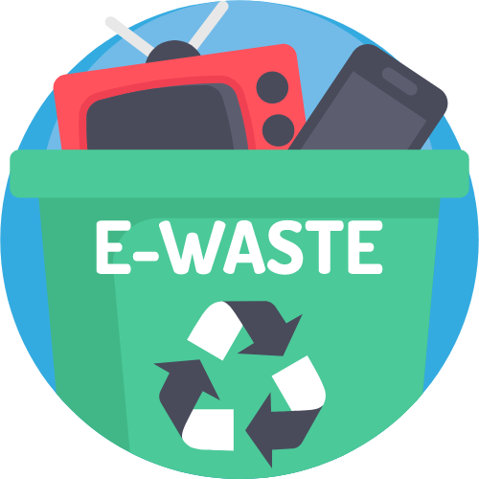
OneStop E-Cycle @NTU
BY JAMESBOND-1
Notes:
Hello and welcome to our project presentation. We are team JamesBond-1 and today we will present our product OneStop E-cycle. *next slide*

Slide 2
TABLE OF CONTENTS
Product Overview
System Design
01
02
Live Demonstration
Future Work
03
04
Mission statement
Expected Users
Features
Design Model
System Architecture
Design patterns
Application features and functionalities
Testing
Maintenance
Road map
Notes:
Okay so first we will give a brief overview of our product, including some background problems, our missions and our solution to the problem. Then we will dive into the technical aspect, describing some of the core functionalities of the application. Lastly, we will give some demonstration and testing of the product.

Slide 3
Product Overview
01

Slide 4
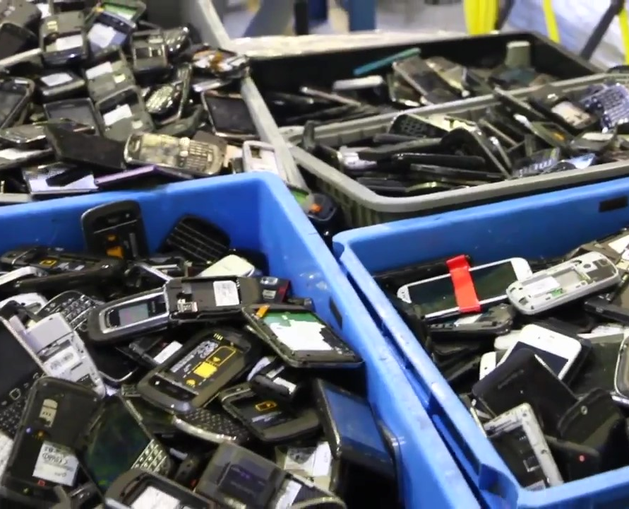
Did you know?
114 kg of electrical and electronic items
are being thrown away every minute in Singapore.
Only 6% of them are recycled!
Notes:
In Singapore alone, 114 kg of electrical and electronic items are being thrown away every single minutes, which adds up to 60,000 tonnes per year. Many components in these devices can be reused, which saves a lot of energy and resources to produce. However, only 6% of those are recycled.

Slide 5
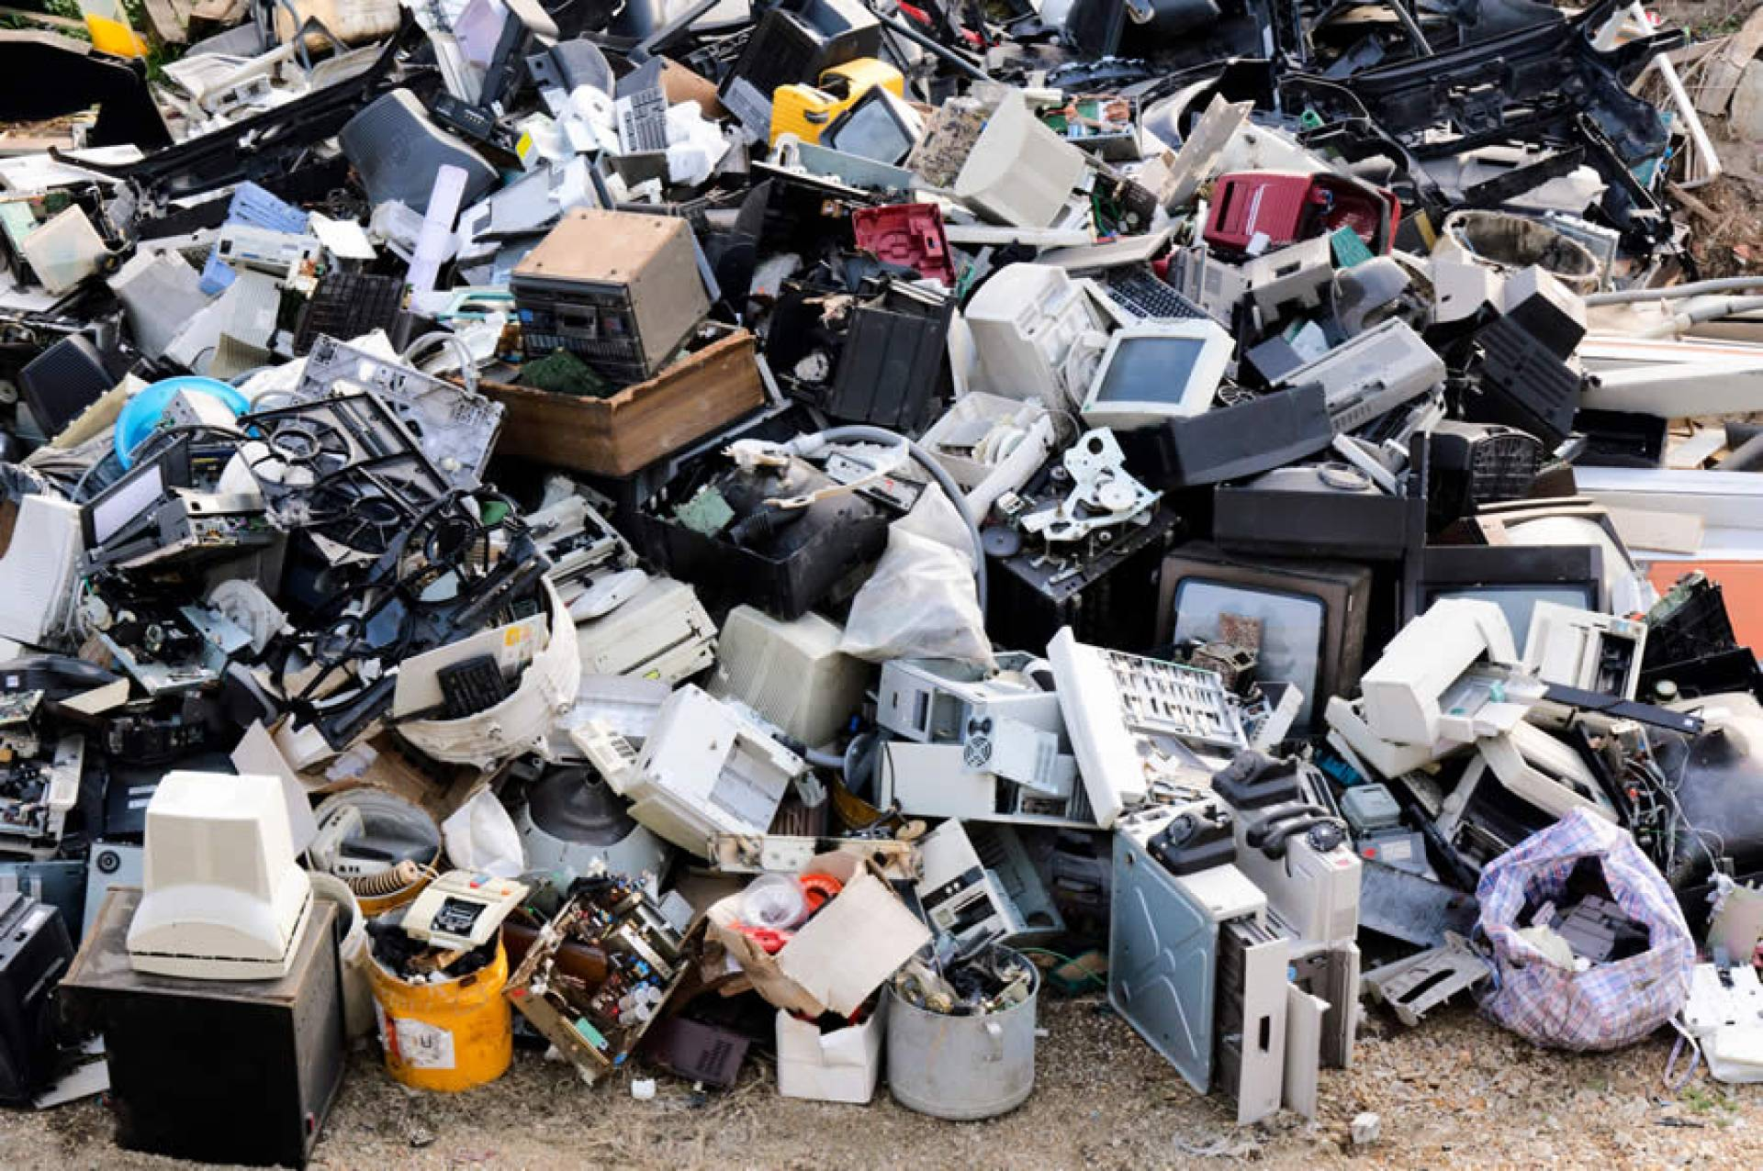
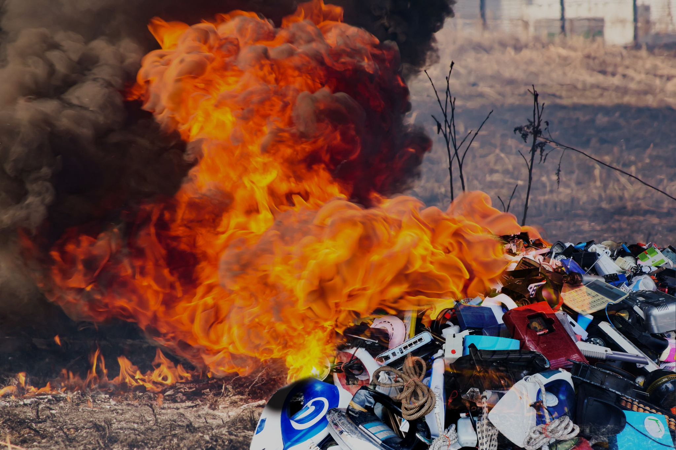
Did you know?
E-waste contains harmful substances and chemicals that affects our health and the environment if it is not processed correctly.
Notes:
The rest of the electronic wastes are sent to dumps in developing countries, where they are shredded and burnt, and a lot of people are being affected by the toxics that they release.

Slide 6
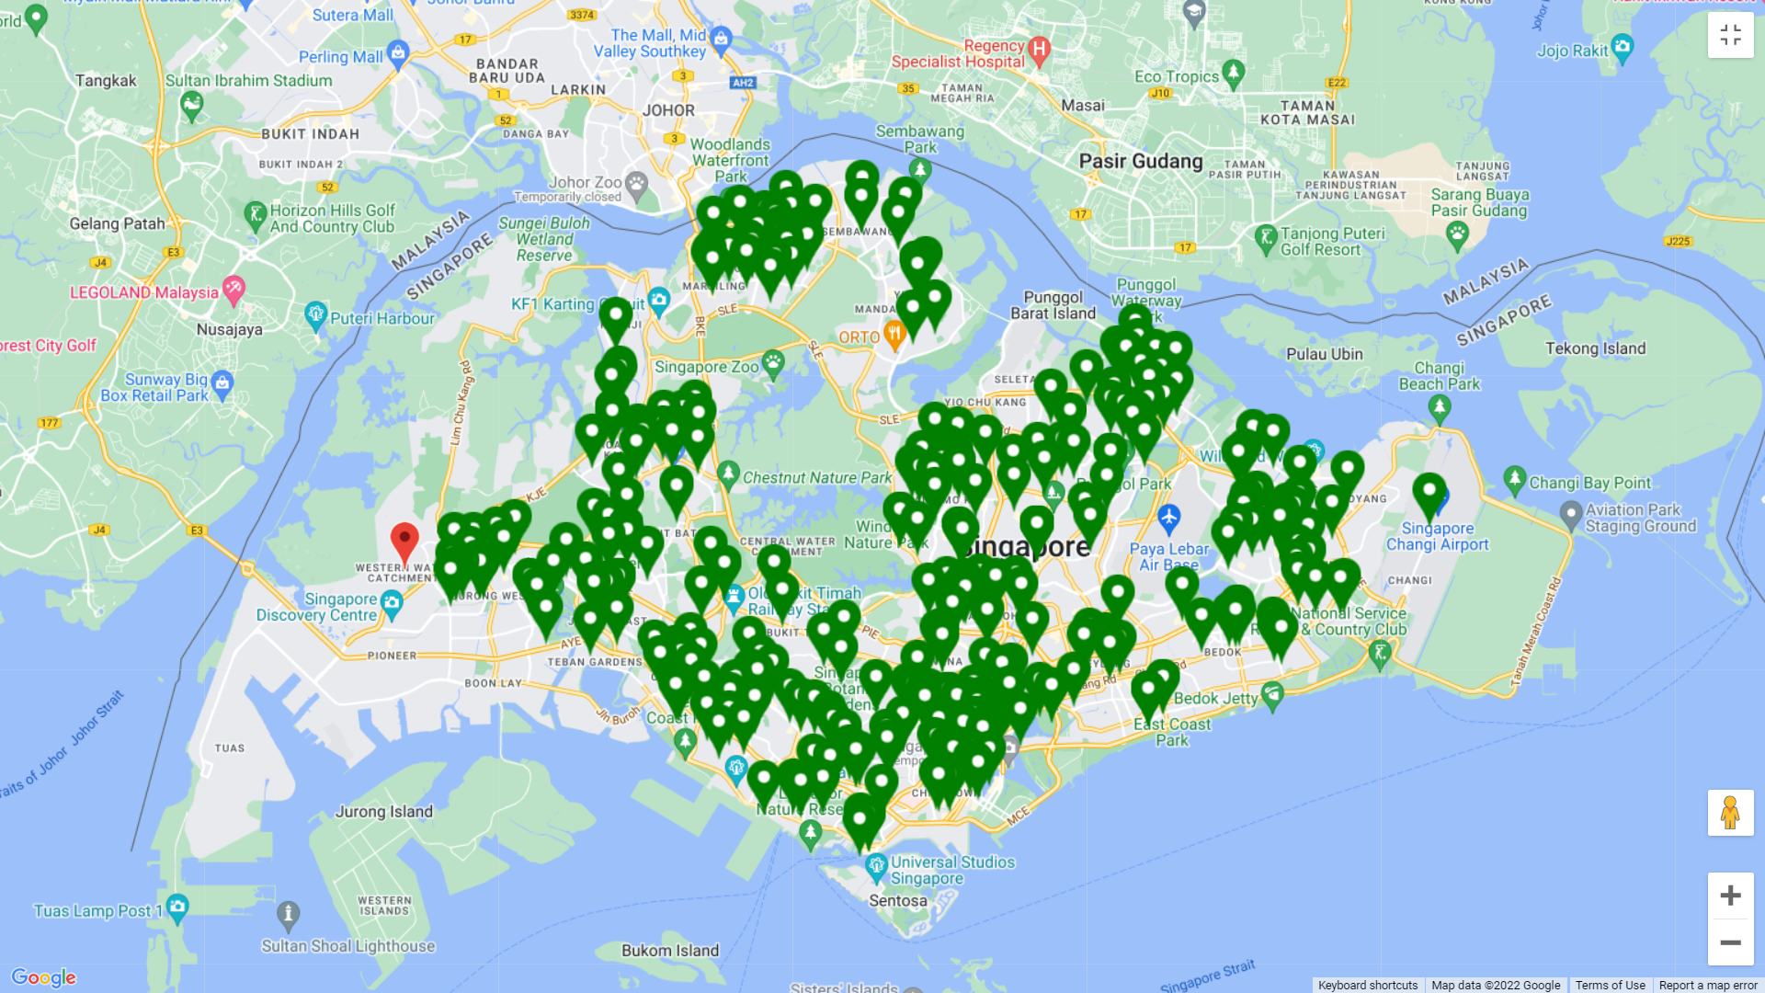
Did you know?
There are over 300 recycling points across Singapore!
Notes:
Seeing this problem, the National Environment Agency has introduced a system of e-waste recycling across all of Singapore in last July. Now, there are over 300 recycling points across Singapore. As a result, the e-waste recycling rate in Singapore has increased by about 30% in the last year. But we believe that it can be even higher.

Slide 7
OneStop E-Cycle
OneStop E-Cycle is a one-stop web-based application for everything about e-waste recycling.
Notes:
This is exactly the motivation for our product. OneStop E-cycle is a one-stop destination for everything about e-waste recycling. We decided to make a web-based application so that people can access more easily.

Slide 8
Mission Statement
An One Stop recycling portal that:
Seamlessly find nearest E-waste recycling point in Singapore.
Gives information about E-waste recycling to enhance people’s awareness of E-waste.
Notes:
Our mission statement is to develop an onestop portal that allows people to seamlessly find recycling points anywhere in Singapore, and provides people with information about e-waste recycling in order to increase public awareness on electronic wastes.

Slide 9




Key Features
Searching for the nearest recycling points for a particular E-waste type
Provide information about E-waste
Allow user to access and register for coming Recycling events in Singapore
Subscribe to email for new events
Notes:
Here are the key features included in our application, including searching for a… We will explain and demonstrate further later in our presentation.

Slide 10

Expected users
People who use electrical and electronic devices.
In Singapore, over 98% of the population uses digital devices. Therefore, our web application can target most of Singapore’s population.
Notes:
Our target audience is simply people who regularly uses electrical and electronic devices. Given that we are living in a generation of electrics, our application can target almost every person in Singapore.

Slide 11
Development Process
02
Notes:
Next, we will go through our development process

Slide 12
SDLC Activities
We incorporates different software process models
Waterfall model: we plan in advanced different phases of software development life cycle
Incremental and iterative development: In the process of development, we design, develop and test each component. We revisit the previous steps to refine the requirements or our design.
Integration and configuration: We reuse existing component, e.g Google Map searching component and configure according to our application.
Requirement specification
Design
Implementation
Testing
Maintenance
Requirement Engineering
Design & Implementation
Notes:
First of all, about our Software development life cycle activities, we incorporate different components from different software process models.
Our main structure is based on waterfall model, where the stages are set and planned. We have 5 different phases: Requirement Specification, design, implementation, testing, and maintenance.
During the development, we also incorporate the incremental and iterative development method. We design, develop and test each component. We also revisit the previous steps to refine the requirements
Moreover, we also use integration and configuration techniques. We reuse existing components, such as Google Map searching component and configure according to our application.

Slide 13
Development principles & practices
Continuous integration
Embrace change
Pair programming & collective ownership
Refactoring
Integrate and test when a new component is ready
Design the system that is change tolerance
Refactor the code immediately when there is possible improvement
Code with each other, provide feedback and support
Notes:
During the development, we adopt some principle and practices
Firstly, continuous integration. As we divide the tasks to different developers, we will integrate the component and test whenever it is ready.
The second one is embrace change. As the application is expected to change, we try to design the system that is change tolerance, that is the change can be accumulated at a relatively low cost.
The third one is pair programming and collective ownership. We code together to provide feedback and support.
The last one is refactoring. When there is a possible improvement, we will refactor our code immediately to optimize it.

Slide 14
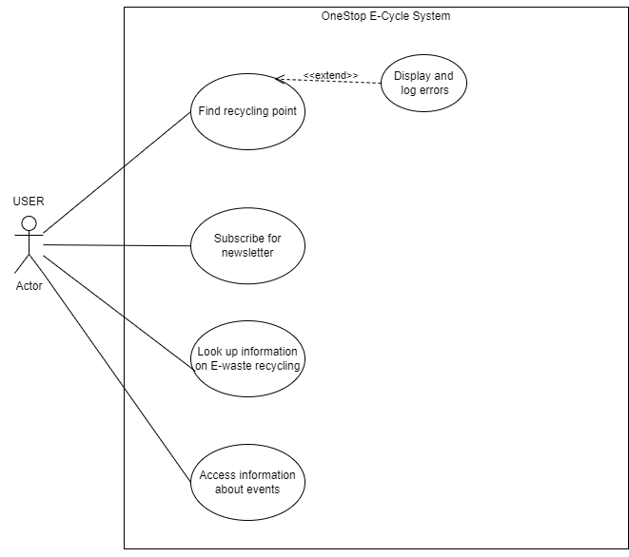
Use Case Diagram
Requirement Specification
Design
Implementation
Demonstration
Maintenance
Notes:
Next, we come to the details of each stage in our software development life cycle. The first one is requirement specifiction.
To understand the requirements, we draw the use case diagram to cover all the functionalities and use cases from external users. As you can see, when a user uses our application, they can view all recycling points in Singapore, find the recycling locations for a specific type of E-waste within a range, look up information about E-waste, and access information about the event. We will use an external API to display the recycling point on the map.

Slide 15
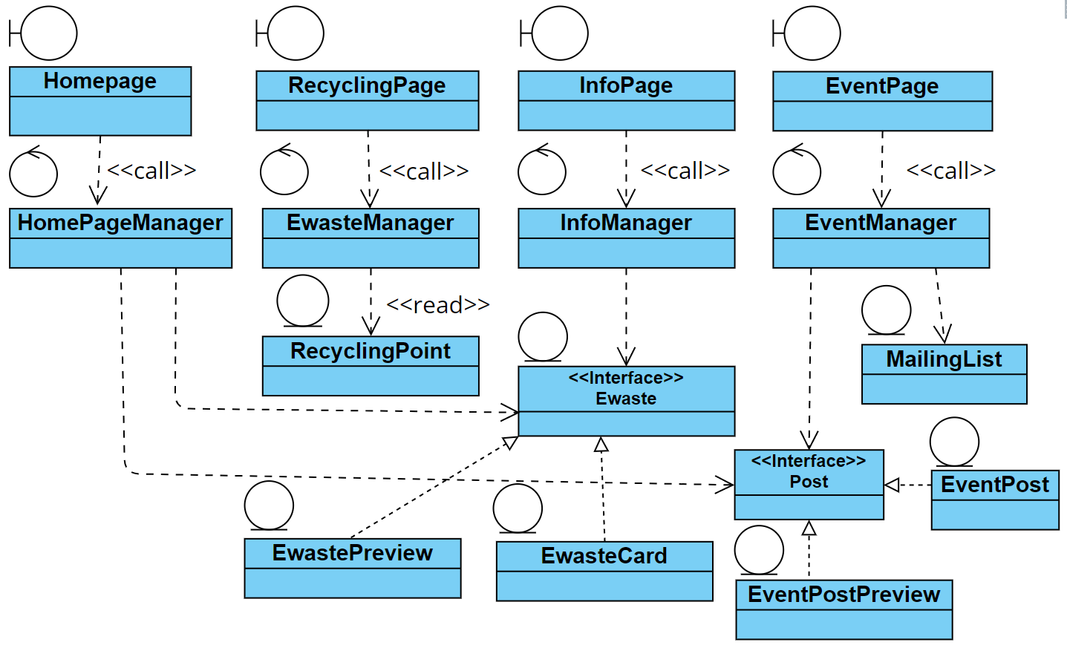
Class diagram
Requirement Specification
Design
Implementation
Demonstration
Maintenance
High cohesion: single responsibility class
Loose coupling
Enable extensibility
Notes:
The recycling page boundary class is where the user can search for the recycling location, it then calls the E-waste Manager, which is the control class, to access information about the recycling point location, saved in the RecyclingPoint Entity class. This class contains the government data we use
The information page boundary will call InfoManager, which then read information about differnet E-waste types. We use an interface as we can have different mod of E-waste such as preview of E-waste or full description of E-waste.
The event page boundary will call the Event manager control class. The event manager will then use Post interface, which is an entity class. We implement it as an interface because we can have different mods of posts such as preview of event post or full description of event posts. Moreover, In case we add more type of posts such as information post, like news about recycling, we will construct create another information post class implementing this interface. This ensures open-closed principle and dependency inversion principle in Object oriented programming.
Moreover, we event manager can also access to the mailing list, which save information of subscribing emails.
Moreover, we also have a homepage to display the preview of the information. Homepage boundary class will call the homepage manager. The homepage manager will then access the information through our interface.
With this class diagram, we ensure that every class has its own responsibility and loosely coupling principle.

Slide 16
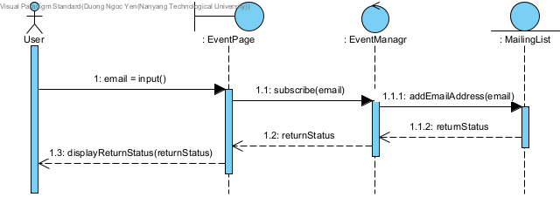
Sequence Diagram
Use case: Subscribing to email for new recycling events in Singapore
Requirement Specification
Design
Implementation
Demonstration
Maintenance
Notes:
To further understand the interaction, we draw the sequence diagram for each use case. Here is an example for the use case: Subscribing to email for new recycling events in Singapore
Next, Duc Anh will further investigate on our designing process.

Slide 17
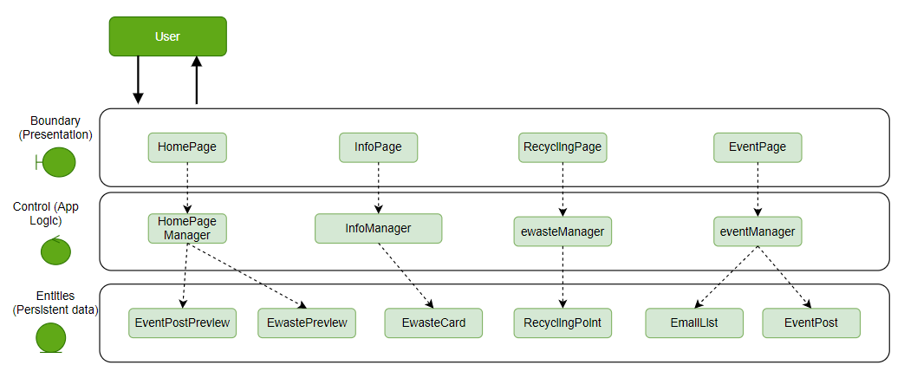
System Architecture
Requirement Specification
Design
Implementation
Demonstration
Maintenance
Notes:
This is our system architecture. We use 3 layered architecture which are presentation, app logic and persistent data layer.
Each web page uses a specific controller and data, hence the system will have extensibility and open for further modification.
The data in the home page is the preview version of the data in info and event page.
Coming to the Info page, we use the information of E-waste type as data and InfoManager is the controller.
We store all the recycling point of E-cycling location and present in the Recycling Page interface.
Event page is presented for accessing e-cycling event information and we also store the email list of subscribed users for informing them the upcoming event

Slide 18
System Architecture
Support enhancement of functionality introducing new components
Support design based on increasing level of abstraction
Support reuse of lower components while upper components varies
Requirement Specification
Design
Implementation
Demonstration
Maintenance
Notes:
The architecture we use satisfy all three advantages above, namely the enhancement of functionality, increasing level of abstraction and the reuse of components

Slide 19
Design pattern
Strategy pattern
Factory pattern
Requirement Specification
Design
Implementation
Demonstration
Maintenance
A strategy pattern is an operational pattern. A set of algorithms or objects should be interchangeable.
Defines an interface for creating different objects, without knowing beforehand what sort of objects it needs to create or how the object is created – lets subclasses decide which class to instantiate
<<interface>>
Post
<<interface>>
Ewaste
EventPost
EventPostPreview
EwastePreview
EwasteCard
Notes:
Our team use two design patterns which are strategy and factory pattern.
A factory pattern is a creational pattern. We create object without violating the creation logic beforehand what sort of object it needs to create. A strategy pattern is a behavioural pattern that enables selecting an algorithm at runtime.
The difference between factory pattern and strategy pattern is that factory pattern focuses on creation of objects while strategy pattern focuses on operation of object.
The key to apply these pattern is interface.
In our application, we use Post interface. Through it, higher classes can instantiate concrete classes that implement the Post interface or make different operations from different subclass. Similarly to the Ewaste interface class, higher level class can create concrete classes that implements Ewaste object and do different operations.
By applying strategy pattern and factory pattern, it helps optimize and keep our code clean as we can separate the concern of different classes and reduce unnecessary repeat of work.
Moreover, these two patterns are also compatible with open-closed principle, which proposed that classes should be open for extension but closed for modification.

Slide 20
Technology
Backend: Firebase, NextJS
Frontend: ReactJS, Tailwind CSS, MUI
Requirement Specification
Design
Implementation
Demonstration
Maintenance
Notes:
The architecture we use satisfy all three criteria above, namely the enhancement of functionality, increasing level of abstraction and the reuse of components

Slide 21

Try it out!
https://onestop-e-cycle.vercel.app

Slide 22
Application level requirement
Responsive design
Single Page Application
Static site generation
Performance
Requirement Specification
Design
Implementation
Demonstration
Maintenance
Website User Interface is properly rendered for on all devices and screen size
Load all contents only once, resulting in performance gain and dynamic experience
Generate template for individual pages and get them ready to serve ahead of times
Test by Lighthouse dev tools. Benchmarking on Web Vitals metrics.
Notes:
This is the demo of our website,
1.Responsive design:
Responsive design mean the UI are displayed properly across multiple device and screen size, since our target users will mostly be on mobile, cuz obviously people won’t bring their computer and run around to recycle E-waste. So we try our best to enhance the UX on mobile and then it becomes fairly easy to extends it to desktop or other devices.
2.Single Page Application:
Another feature we would like to provide is single page application behavior. This mean our implementation allow user to load only a single web document, and then updates the body content of that single document or routing between pages via pre-built routers.
This therefore allows users to use websites without requesting additional data upon routing, which can result in performance gains and a more dynamic experience. Normally this would result in a tradeoff in Search Engine Ranking (SEO) performance and more effort in performance monitoring. But thanks to Next/Link built in passHref attributes, the trade off can be ease out and this will bring me to the final point.
3.Static Site Generation:
A static site generator is a tool that generates a full static HTML website based on raw data and a set of templates. Essentially, a static site generator automates the task of coding individual HTML pages and gets those pages ready to serve to users ahead of time. Because these HTML pages are pre-built, they can load very quickly in users' browsers.
So what we have here is a Markdown (.MD extension file) content management systems (CMS) system. Which is a very light weight CMS built by utilizing nextJS getStaticProps() features. So it’s dynamic in some sense and we got lots of flexibility here. Whenever we need to add or modify a new event posts, we can just pass through the API and it will handle the remaining job to render and style it on our web page.
4. Performance on Core Web Vitals metrics:
[Run Light House testing live …]
Web Vitals score a user's experience loading a webpage. These metrics score how quickly page content loads, how quickly a browser loading a webpage can respond to a user's input, and how unstable the content is as it loads in the browser. These three metrics are going to be bundled alongside Mobile Friendliness, Safe Browsing, HTTPS and Intrusive Interstitials into Google’s "Page Experience Signal". These will then being pass on to browser algorithm to rank our page.
So performing well on this metrics also mean that’s your site is performant and reliable, now report from chrome Light House should be ready. [Comment on result].
That’s for app-wise requirements!

Slide 23
Component level requirements
Map API, geolocation data
Search filters, autocomplete
Email subscription
Requirement Specification
Design
Implementation
Demonstration
Maintenance
Google map API is configured, geo-data is stored in Firebase
Distance and e-waste type filters, autocomplete function for search engine
Email is stored without duplicate, pop-up is handled properly.
Map UI is configured and rendered properly.
Type filters and distance filters work properly.
Pop up UI is rendered.
Regex validation .
Markers, Info Windows are rendered.
Autocomplete works, search flow complete successfully.
Duplication elimination.
Notes:
Next is requirement at component levels, 1. Google Map:

Slide 24
Sequence Diagram
Use case: Subscribing to email for new recycling events in Singapore
Requirement Specification
Design
Implementation
Demonstration
Maintenance
Notes:
This is the sequence diagram of email subscription function.

Slide 25
Component level requirements
Pop-up card component
Metadata and favicon
Requirement Specification
Design
Implementation
Demonstration
Maintenance
Pop-up card appears on click and backgrounds, styling are displayed
Page title, CSS, favicon and Open Graph attributes are properly configured
Font, background, buttons is working.
Website favicon and title is rendered.
Pop-up is discarded correctly.
Website preview picture is rendered properly

Slide 26
Maintenance
Refactoring codebase
Functional addition and modifications
Fault repair
Requirement Specification
Design
Implementation
Demonstration
Maintenance
Notes:
As for software Maintenance, In the future, we would

Slide 27
Future work
Adding more types of waste such as plastic waste, organic waste
Extend the range to different countries
Recycling service for business and organization
Requirement Specification
Design
Implementation
Demonstration
Maintenance

Slide 28
Thank You

